Slide 1
Agustin PICARD*, Lucas HERVIER*, Thomas FEL, David VIGOUROUX

Slide 2
Table Of Contents
Introduction to Influence Functions
Motivations
Influenciae
Going from maths to code
Demonstration
Perspectives

Slide 3
Introduction to Influence Function
What is Influence Function?
“The influence curve is essentially the first derivative of an estimator, viewed as functional, at some distribution (in an infinite-dimensional space), and it is shown how it can be used not only to derive asymptotic variances, but also to study several local robustness properties which are defined and intuitively interpreted.”
Ref. Frank R. Hampel. The influence curve and its role in robust estimation. Journal of the American Statistical Association, 1974, http://www.jstor.org/stable/2285666

Slide 4
Introduction to Influence Function
What is Influence Function ? (Easy version)
“Given a data point, a model, and the rest of the data that went into creating the model, the Influence Function measures how much of a positive or negative impact did the data have on the model’s current state”
Adapted from this blog

Slide 5
Introduction to Influence Function
A simple example: Cook’s Distance
We want to estimate a linear model: $Y=Xβ+ ε$:
$shape\left(Y\right)=n ×1, shape\left(X\right)=n ×p$
$rank\left(X\right)=p$
$Cov\left(ε\right)= σ^{2}I$
Least squares estimator of $β$ is $\hat{β}={(X^{T}X)}^{−1}X^{T}Y$
Estimate of $σ^{2}$ is $s^{2}= Y^{T}\left(I −{X\left(X^{T}X\right) }^{−1}X^{T}\right)Y/(n −p)$
Ref. R. Dennis Cook and Sanford Weisberg. Characterizations of an empirical influence function for detecting influential cases in regression, 1980, https://www.jstor.org/stable/1268187

Slide 6
Introduction to Influence Function
A simple example: Cook’s Distance
We denote with the subscript $(i)$ a quantity « with the $i$-th case deleted »
Examples:
$X_{(i)}$ is an $\left(n −1\right) ×p$ matrix derived from $X$ by deleting the $i$-th row $x_{i}^{T}$
${\hat{β}}_{\left(i\right)}= {(X_{\left(i\right)}^{T}X_{(i)})}^{−1}X_{\left(i\right)}^{T}Y_{(i)}$
Ref. R. Dennis Cook and Sanford Weisberg. Characterizations of an empirical influence function for detecting influential cases in regression, 1980, https://www.jstor.org/stable/1268187

Slide 7
Introduction to Influence Function
A simple example: Cook’s Distance
The empirical Influence Function is:
$${IF}_{A}=({\hat{β}}_{\left(i\right)}− \hat{β})$$
And we can define the Cook’s distance:
$D_{i}\left(X^{T}X, ps^{2}\right)= \frac{{\left({\hat{β}}_{\left(i\right)}− \hat{β}\right) }^{T}(X^{T}X)({\hat{β}}_{\left(i\right)}− \hat{β}) }{ps^{2}}$
Ref. R. Dennis Cook and Sanford Weisberg. Characterizations of an empirical influence function for detecting influential cases in regression, 1980, https://www.jstor.org/stable/1268187

Slide 8
Introduction to Influence Function
A simple example: Cook’s Distance
Cook’s distance:
$$D_{i}\left(X^{T}X, ps^{2}\right)= \frac{{\left({\hat{β}}_{\left(i\right)}− \hat{β}\right) }^{T}(X^{T}X)({\hat{β}}_{\left(i\right)}− \hat{β}) }{ps^{2}}$$
“ [A]side from the scale factor $ps^{2}$ [this distance is] the ordinary squared Euclidean distance that the fitted vector moves when removing the $i$th case is deleted from the data .”
Ref. R. Dennis Cook and Sanford Weisberg. Characterizations of an empirical influence function for detecting influential cases in regression, 1980, https://www.jstor.org/stable/1268187

Slide 9
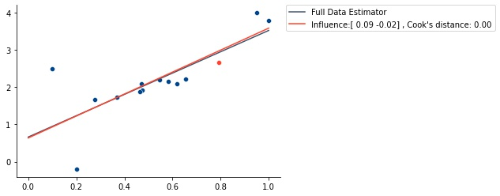
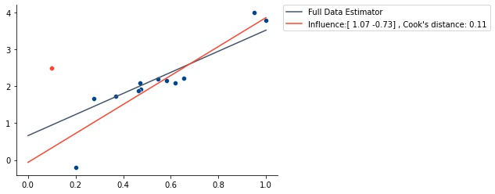
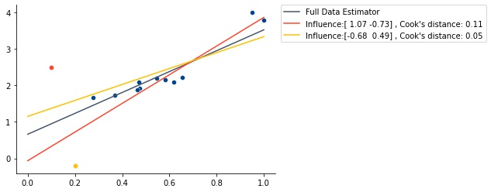
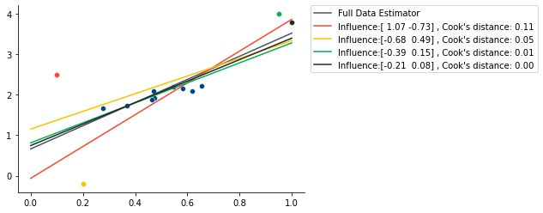
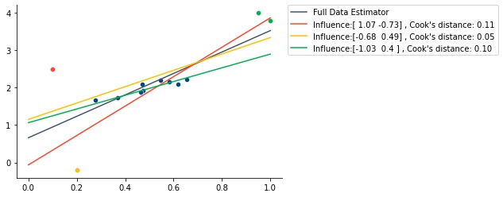
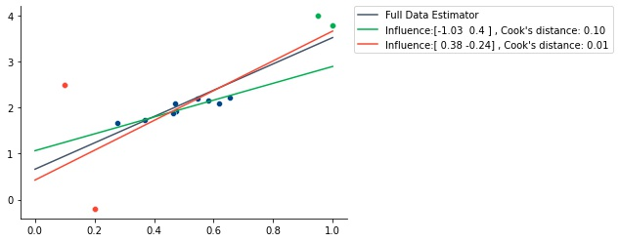
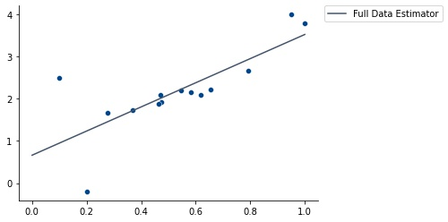
Introduction to Influence Function
A simple example: Cook’s Distance
Ref. R. Dennis Cook and Sanford Weisberg. Characterizations of an empirical influence function for detecting influential cases in regression, 1980, https://www.jstor.org/stable/1268187

Slide 10
Motivations
Influence Functions capture the core idea of studying models through the lens of their training data.
It can be derived for a variety of tasks :
Understanding model-behavior
Debugging models
Mislabelling detection
Example-based XAI
….

Slide 11
Motivations
Pretty cool, isn’t it ? But what if I have an Artificial Neural Network ?
More complex architecture
Possibly many more parameters
Retraining is a long process
For a long time it was not possible to even dream of using Influence Function for ANN ...

Slide 12
Motivations
In 2017 two people are gonna change EVERYTHING (well almost)!
Pang Wei Koh and Percy Liang, Understanding black-box predictions via influence functions, 2017, https://arxiv.org/abs/1703.04730

Slide 13
Motivations
What did they do ?
They propose a mathematical formulation that is easily applicable to Neural Networks :
$$ℐ_{up, params}\left(z\right)=−H_{\hat{θ}}^{−1}∇_{θ}l(z, \hat{θ})$$
where $H_{\hat{θ}}= \frac{1}{n} \sum_{i=1}^{n}{∇_{θ}^{2}l(z_{i}, \hat{θ})}$ is the Hessian and is assumed to be positive definite.
Pang Wei Koh and Percy Liang, Understanding black-box predictions via influence functions, 2017, https://arxiv.org/abs/1703.04730
Notes:
hanks to their built-in ability to compute gradients on modern auto-differentiation ML frameworks

Slide 14
Motivations
In addition:
By applying the chain rule they posit that the influence of upweighting $z$ on the loss at a test point $z_{test}$ can be computed as follow:
$$ℐ_{up, loss}\left(z, z_{test}\right)=−∇_{θ}l{\left(z_{test}, \hat{θ}\right)}^{T}H_{\hat{θ}}^{−1}∇_{θ}l(z, \hat{θ})$$
Pang Wei Koh and Percy Liang, Understanding black-box predictions via influence functions, 2017, https://arxiv.org/abs/1703.04730
Notes:
hanks to their built-in ability to compute gradients on modern auto-differentiation ML frameworks

Slide 15
Motivations
However…
The authors raise the issue of the computational challenge of calculating and inverting the Hessian with respects to the parameters, a problem that grows quadratically with the amount of the model’s parameters…
Use implicit Hessian-vector products (HVPs) for approximation.
Pang Wei Koh and Percy Liang, Understanding black-box predictions via influence functions, 2017, https://arxiv.org/abs/1703.04730
Notes:
2 Techniques: Conjugate Gradients and Stochastic estimation

Slide 16
Motivations
Since then…
Many papers have been proposed to leverage Influence Function for Deep Neural Networks. However :
Implementations are not always provided
Codes available are not easy to customize
Implementations were not always thought to scale
All Use Cases were not addressed
There was no unified framework (in TensorFlow)
Notes:
2 Techniques: Conjugate Gradients and Stochastic estimation

Slide 17
Influenciae
That is why…
Notes:
2 Techniques: Conjugate Gradients and Stochastic estimation

Slide 18
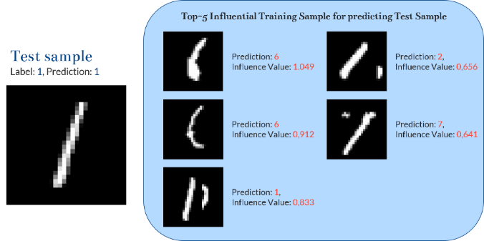
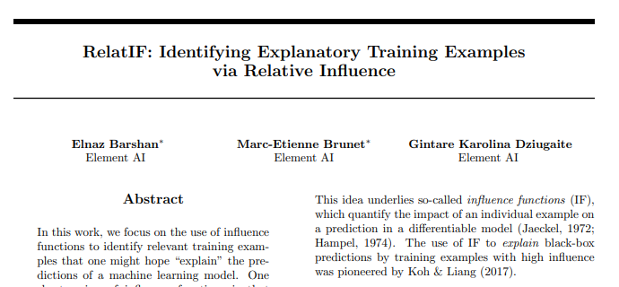
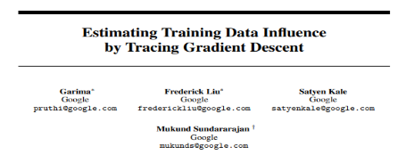
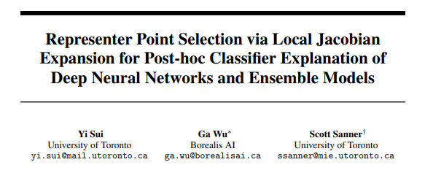
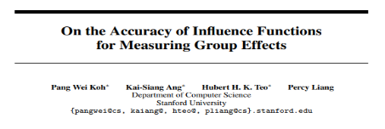
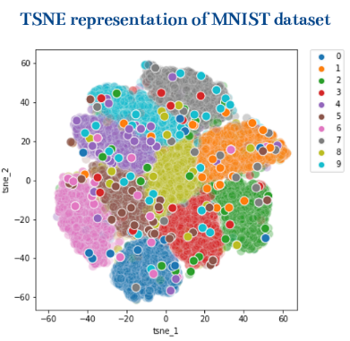
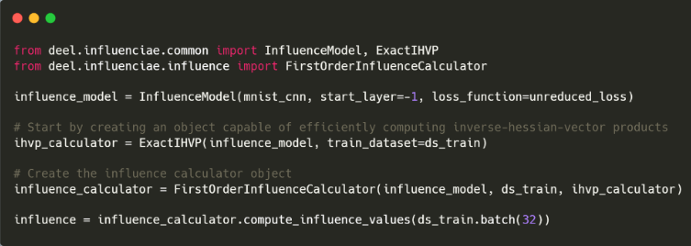
Influenciae
A Tensorflow Toolbox for Influence Functions
Optimized for Tensorflow / Keras ecosystem.
Agustin PICARD*, Lucas HERVIER, David VIGOUROUX, Thomas FEL
(1) State-of-the-art Influence Function implementations: 6 methods and more on the way!
(3) Example-based XAI to gain knowledge on your model’s prediction!
But also:
Understanding model-behavior
Debugging models
Mislabelling detection
(2) Tutorials 7 Colab notebooks to get your hands on the tool’s possibilities !
onc
(4) On-going development
github.com/deel-ai/influenciae
Benchmark tools
Evaluation of the different methods
Uncertainty estimation
Implementation optimization
…
See also: github.com/deel-ai/xplique
Learn to gain insights into your dataset!

Slide 19
Going from maths to code
Pang Wei Koh and Percy Liang, Understanding black-box predictions via influence functions, 2017, https://arxiv.org/abs/1703.04730
Remember that:
$$ℐ_{up, params}\left(z\right)=−H_{\hat{θ}}^{−1}∇_{θ}l(z, \hat{θ})$$
To be tractable on models with a high number of parameters we may want to focus only on the last layer(s)
We wrote an Influence Model Wrapper to facilitate the work
Notes:
2 Techniques: Conjugate Gradients and Stochastic estimation

Slide 20
Going from maths to code
Pang Wei Koh and Percy Liang, Understanding black-box predictions via influence functions, 2017, https://arxiv.org/abs/1703.04730
And that: “ Use implicit Hessian-vector products (HVPs) for approximation”
We implemented the 2 methods they used to do so:
Notes:
2 Techniques: Conjugate Gradients and Stochastic estimation

Slide 21
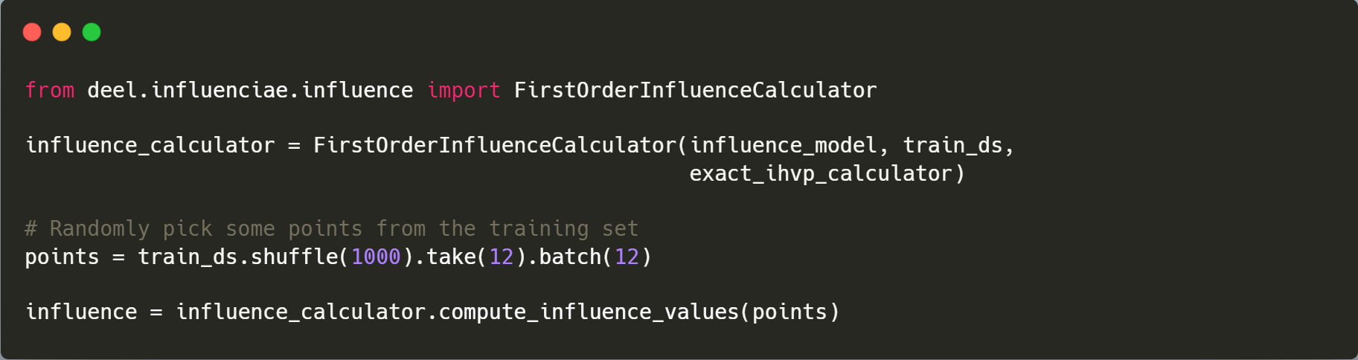
Going from maths to code
Pang Wei Koh and Percy Liang, Understanding black-box predictions via influence functions, 2017, https://arxiv.org/abs/1703.04730
Finally, we can compute Cook’s distance as they defined with a simple call on our API:
Notes:
2 Techniques: Conjugate Gradients and Stochastic estimation

Slide 22
Going from maths to code
Pang Wei Koh and Percy Liang, Understanding black-box predictions via influence functions, 2017, https://arxiv.org/abs/1703.04730
What about this formula:
$$ℐ_{up, loss}\left(z, z_{test}\right)=−∇_{θ}l{\left(z_{test}, \hat{θ}\right)}^{T}H_{\hat{θ}}^{−1}∇_{θ}l(z, \hat{θ})$$
Notes:
2 Techniques: Conjugate Gradients and Stochastic estimation

Slide 23
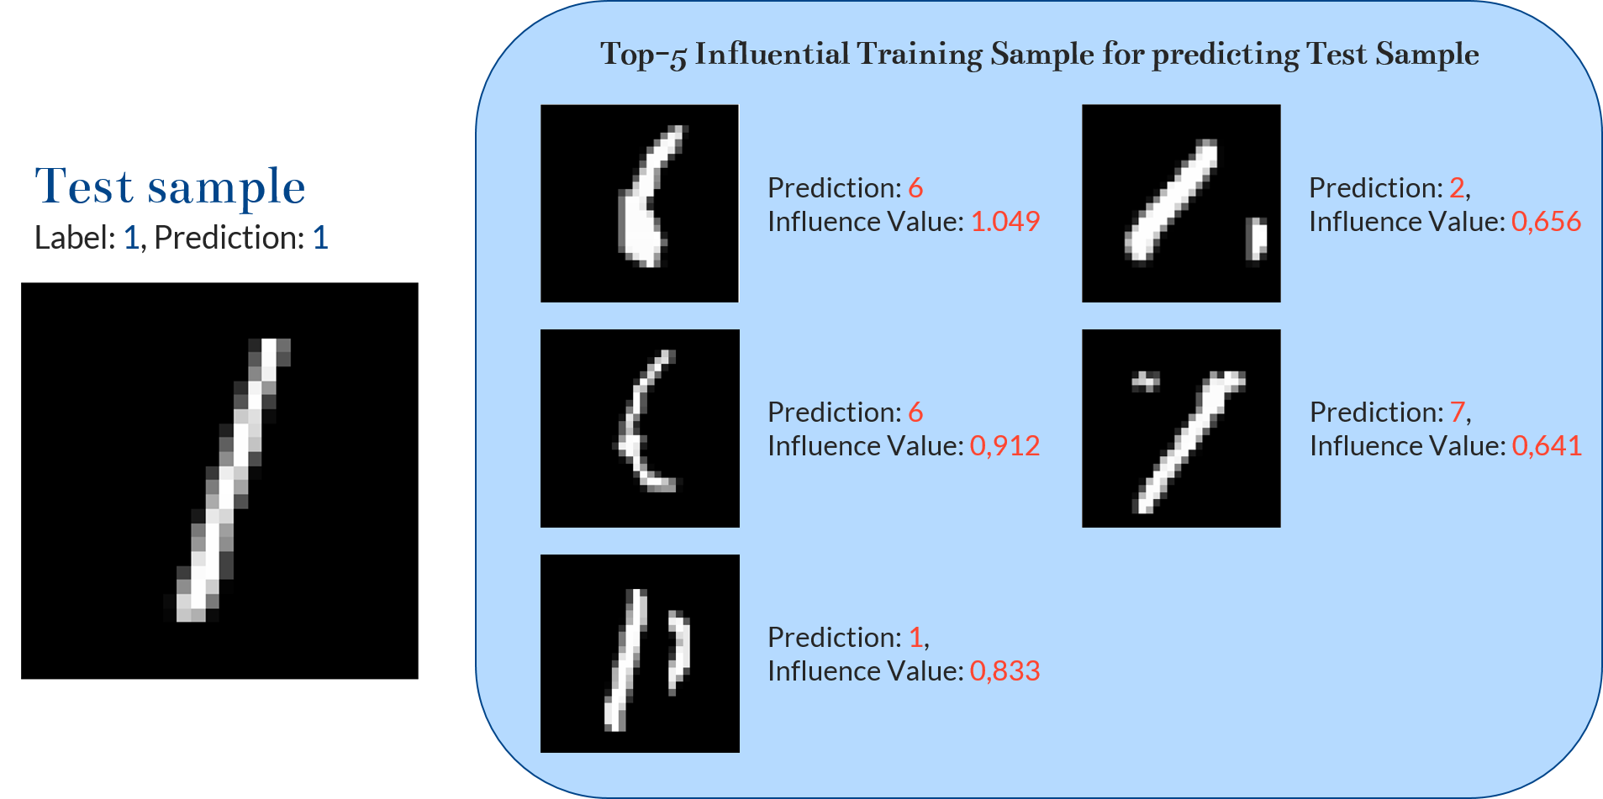
Going from maths to code
Pang Wei Koh and Percy Liang, Understanding black-box predictions via influence functions, 2017, https://arxiv.org/abs/1703.04730
Notes:
2 Techniques: Conjugate Gradients and Stochastic estimation

Slide 24
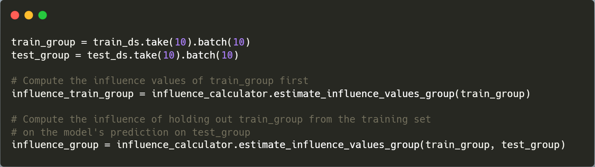
Going from maths to code
Pang Wei Koh and Percy Liang, Understanding black-box predictions via influence functions, 2017, https://arxiv.org/abs/1703.04730
Pang Wei Koh, Kai-Siang Ang, Hubert H. K. Teo, Percy Liang. On the Accuracy of Influence Functions for Measuring Group Effects, 2019, https://arxiv.org/abs/1905.13289
Propose a way to measure the influence of removing « group » of data points
Notes:
2 Techniques: Conjugate Gradients and Stochastic estimation

Slide 25
Demonstration
Demonstration

Slide 26
Perspectives
Integrate newest methods
Benchmark
Develop Example-based XAI
Uncertainty Estimation
Evaluate approximations
Extend to other UCs

Slide 27
Thank you for your attention!
Any questions left?

